Slide 1
Unit 4
Don’t eat in class.
Section B 2a-2c
七年级(下)

Slide 2

Objectives
To learn to write rules at home and school
To learn to use have to/must, can and can’t

Slide 3

Think about it
What are the rules in your home?
Look at the following pictures
and say the rules.

Slide 4
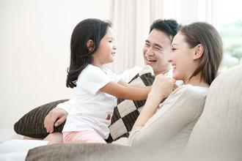
My Family Rules
Don’t talk loudly at home.

Slide 5

Don’t _________late at night.
watch TV

Slide 6
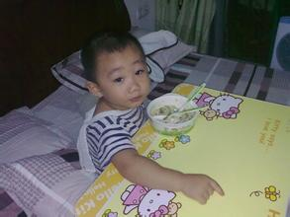
Don’t_____________.
eat in the bed

Slide 7
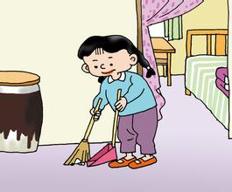
She______ clean the bedroom on Sunday.
has to

Slide 8
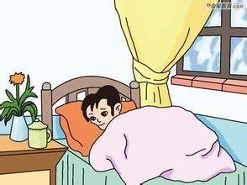
____________too late on Sunday.
Don’t get up

Slide 9
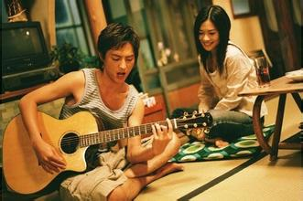
___________________late at night.
Don’t play the guitar

Slide 10
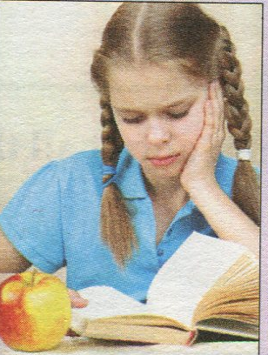
2a. When you are unhappy about something,
who do you like to talk to ?
Parents
Classmates
Teachers
Friends
Strangers
…
2b.Read the letters. Underline the rules
for Molly.

Slide 11


Dear Dr. Know,
There are too many rules! At 6:00
a.m., my mom says, “ Get up now
and make your bed!” After
breakfast, my mom always says,
“Don’t leave the dirty dishes in
the kitchen!” After that, I run to
school because I can’t be late.
At school, we have more rules-don’t
be noisy, don’t eat in class,…

Slide 12
My dad says I can’t play basketball
after school because I must do my
homework. I can play only on
weekends. After dinner, I can’t relax
either. I must read a book before
I can watch TV. But I have to go to
bed before10:00. Rules, rules, rules!
It’s terrible! What can I do,
Dr. Know?
Molly Brown, New York

Slide 13
Dear Molly,
I know how you feel. People always tell us, “Don’t do this!” or “You can’t do that!” But think about it, Molly. There are a lot of things you can do. You can play basketball on weekends. You can watch TV after you read a book. Parents and schools are sometimes strict, but remember, they make rules to help us. We have to follow them.
Good luck!
Dr. Know

Slide 14
2c. Read the letters again and complete
the sentences with have to / must, can or can’t.
Molly play basketball on school days, but she
______ play it on weekends.
can’t
can
must
2.Molly do her homework first when she gets home.
has to
3. Molly read a book after dinner before she
______ watch TV.
can
4. At school, Molly be noisy or eat in class.
can’t
5. Parents and schools make rules to help students.
So students follow the rules.
have to

Slide 15
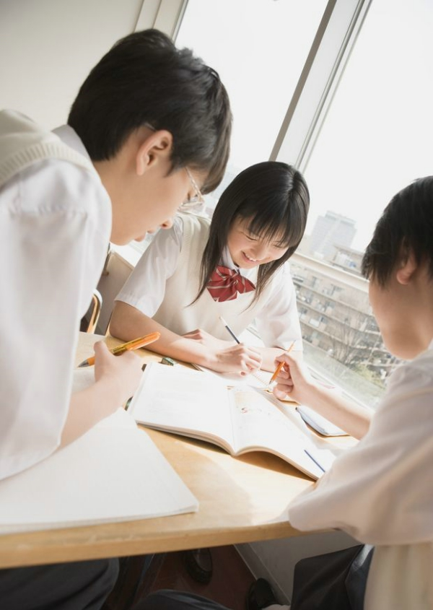
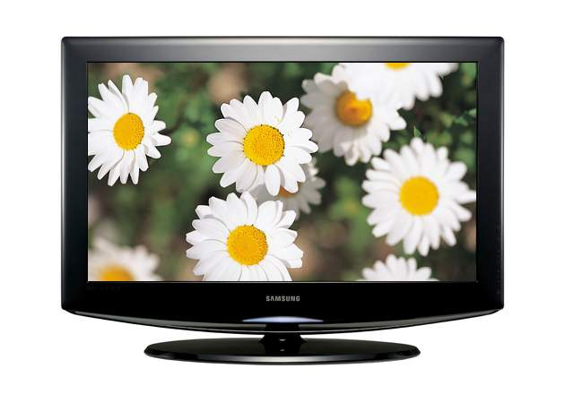
Pair work
I have to do my homework
after school. And I can’t
watch TV on school nights.
…

Slide 16
Language points
1. Dear Dr. Know
Dr.为doctor（博士；医生；医师）一词的缩写形式，放于姓氏之前，表示对人的尊称。Dr.采用的是首尾缩写法，取首字母和词尾字母将单词进行缩写。
2. make the bed/make one’s bed 整理床铺
e.g. Bob always makes his bed himself.
鲍勃总是自己整理床铺。
Can you make the bed? 你会整理床铺吗？

Slide 17
3. noisy adj. 意为“吵闹的”
e.g. We can’t be noisy in class.
我们不能在教室里大吵大闹。
4. practice v. 意为“练习”后面可跟名
词、代词或动名词。
用作名词时，是不可数名词。
e.g. I must practice English every morning.
我每天早晨必须练习英语。
Mr. Xu practices doing kong fu every
day. 许先生每天练习功夫。

Slide 18
5. After dinner, I can’t relax either. 晚饭后我也不能放松。
副词either表示“也”，用于否定句句末，用法与表示肯定或陈述的副词too相似，可用逗号与语句的主题隔开。
e.g. You like English. I like it, too.
你喜欢英语，我也喜欢。
My father can’t speak English. My
mother can’t (speak it), either.
我爸不会讲英语，我妈也不会。

Slide 19
6. before 在……之前; after 在……之后；
它们的后面可以跟表示时间的点，也可以跟一个从句表示时间。
e.g. Wash your hands before dinner.
饭前洗手。
Do your homework after school.
放学后做作业。

Slide 20
Brush your teeth before you go to bed.
睡前刷牙。
Mrs. Wu usually makes dinner for the family first after she gets home.
吴太太在到家之后通常先为家人做饭。
7. be strict (with sb.) (对某人)严格的
e.g. Our math teacher is very strict.
我们的数学老师很严格。
Are your parents strict with you?
你的父母对你严格吗？

Slide 21
8. There are a lot of things you can do.
你有许多可以做的事情。
此句中a lot of things you can do是一个名词短语，句子you can do起着修饰，限定名词things的作用。英语中当句子限定修饰名词时要放在该名词之后。
e.g. There are a lot of songs you can sing.
有许多你可以唱的歌曲。

Slide 22
9. There are too many rules!
too many＋可数名词复数, “太多”
e.g. I have too many books to read.
too much＋不可数名词, “太多”
e.g. There’s too much milk in the glass.

Slide 23
10. I have to go to bed before ten o’clock.
go to bed “上床睡觉”, 此时等于 be in bed,
in和bed之间不能用冠词, bed也不用复数,
be in bed 还有“卧床”的意思 。
e.g. He is in bed for 10 years. 他卧床10年了。
Dave has to be in bed early every night.
大卫每晚必须很早睡觉。

Slide 24
Quiz

Slide 25
根据句意及首字母提示完成单词。
1. Alan has to go to bed b______ 9 o’clock
in the evening.
2. The room is too d____. Let’s clean it.
3. You can watch TV or listen to music to
r____ after you finish your homework.
4. Lucy is a nice girl. She has long black
h____.
5. Please r_________ to bring your
homework to school next Monday.
efore
irty
elax
air
emember

Slide 26
根据汉语提示填入恰当的短语完成句子。
go out
1. -- Can we ______ (出去) on school days?
-- No, you can’t.
2. Let me help you ___________ (洗餐具).
3. Our English teacher Miss Li is very
__________ (对……严格) us.
4. Chinese people think red can bring
them _________ (好运).
5. As (作为) a student, we must _________
______ (遵守规则) at school.
do the dishes
strict with
good luck
follow the
rules

Slide 27
下列各句中均有一处错误，请找出并改正。
1. I have to in bed by 10:00 every night.
___________
2. The children never have some fun at
school. ____________
3. Simon can’t go out at school nights.
__________
4. I’m busy today. There is too many work.
_____________
5. You can’t have to wear your uniform at
home. __________________
in前面加be
some改为any
at改为on
many改为much
can’t改为don’t

Slide 28
根据汉语提示补全英语句子，每空一词。
1. Can you come back ___ ____ _______
(十点之前)?
2. We can’t _____ _______(大声讲话)
in the meeting hall.
3. She has to clean the room and _____
______ _______ (洗衣服).
4. Wow, there are ____ _____ ______ (太
多书) in the room.
5. How about going to the music club to
______ ____ _____ (学习弹吉他)?
by ten o’clock
talk loudly
wash
the clothes
too many books
learn the guitar

Slide 29
情景交际。从方框中选择恰当的句子完成对话，有两个多余选项。
A. There are too many rules in my school.
B. Well, what can you do at school?
C. What do you have to do?
D. Do you have fun at your school?
E. Can you help me?
F. We can’t eat in the classroom.
G. Do you have to wear uniforms at school?

Slide 30
D
A: Hey, May. (71)_____
B: No, I don’t.
A: Why?
B: (72) _____
A: What are the rules?
B: We can’t arrive late for school. (73)___
We can’t...
A: (74) ____
B: We can listen to music in the hallways.
A: (75) _____
B: No, we don’t. We can wear our own (自
己的) clothes. I only like this rule.
A
F
B
G

Slide 31
Translate and write them down.
1. 我家有太多的家规。
2. 他十点前就不得不睡觉。
3. 你在家里不得不做什么？
4. 我放学后不能和朋友见面因为我不
得不做家庭作业。
I have too many rules in my house.
He has to be in bed by ten o’clock.
What do you have to do in your home?
I can’t meet my friends after school because I have to do my homework.

Slide 32
Thank You!

